Slide 1
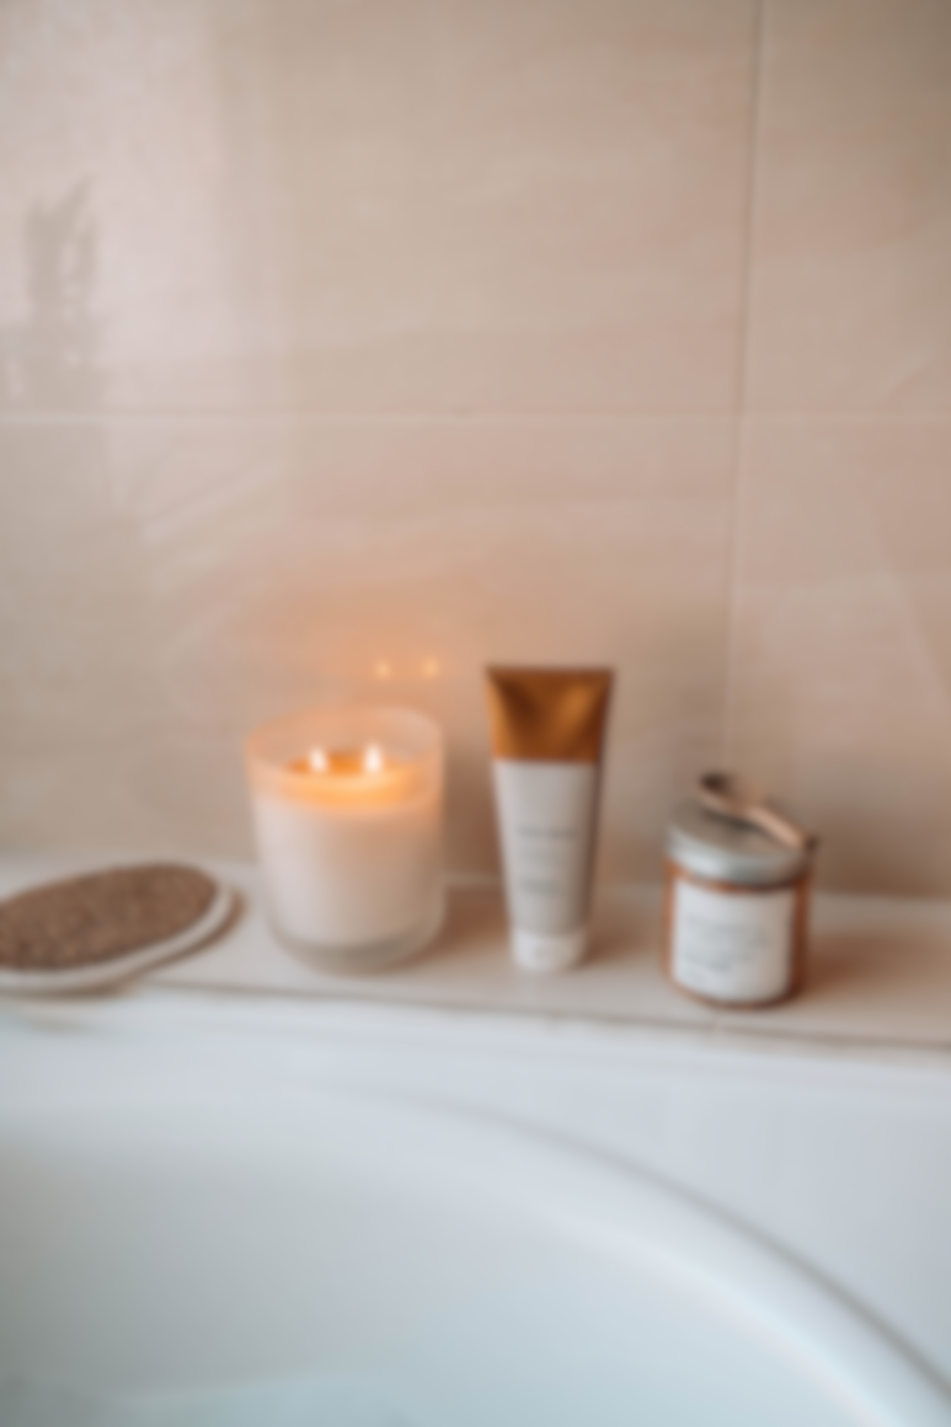


“I’m beyond impressed! My skin feels incredibly soft and hydrated, and I've noticed a visible reduction in fine lines and dark spots. Highly recommend to anyone looking to boost their skincare routine!"
Isabel Mercado
@reallygreatsite

